Slide 1


Manage your VNF with a Helm Execution Environment
https://www.5gasp.eu
1st Review

Slide 2
How can Helm Charts be used to configure VNFs?
OSM’s Execution Environments (EEs) provide a runtime framework to run primitives. These EEs provide the means for NF-specific management code to run it into a dedicated helm chart.
OSM
Execution Environment
VNF
Helm Chart
1st Review
https://www.5gasp.eu

Slide 3
Understanding OSM Execution Environment
OSM communicates with its EE to trigger actions via gRPC calls, which are handled by a frontend component (running in a pod) in its constituent Helm Chart.
The Helm Chart can contain, for example, Ansible Playbooks that simplify the VNF configuration.
Execution Environment
Helm Chart
OSM
VNF
Executes gRPC Call
gRPC Pod
Executes Ansible Playbooks to configure VNF
https://www.5gasp.eu

Slide 4
Our Goal
Understanding and creating an Helm Chart that OSM can interact with.
Creating your own Ansible playbooks to perform day-1 and day-2 operations.
Understanding how VNF Descriptors can refer to your Helm Chart and Ansible Playbooks.
https://www.5gasp.eu

Slide 5
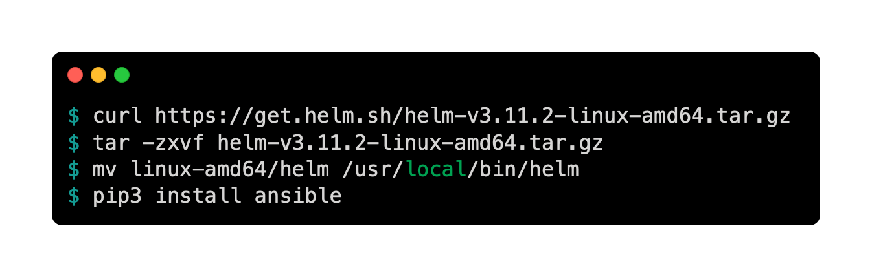
First of all, let’s start by downloading Helm and Ansible
$ curl https://get.helm.sh/helm-v3.11.2-linux-amd64.tar.gz
$ tar -zxvf helm-v3.11.2-linux-amd64.tar.gz
$ mv linux-amd64/helm /usr/local/bin/helm
$ pip3 install ansible
https://www.5gasp.eu

Slide 6
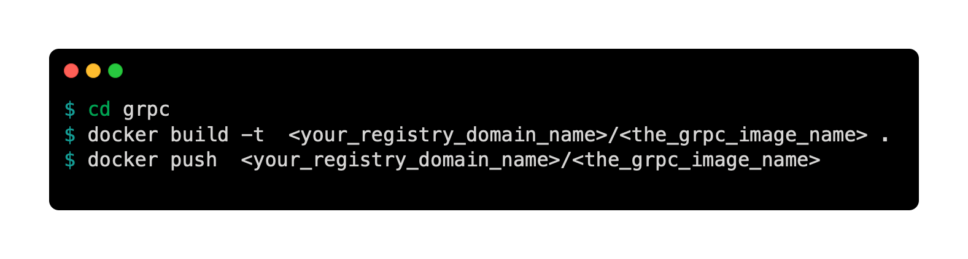
OSM’s gRPC Image
The code used has been adapted from OSM's. Thus, you should build the Docker image and push it to your Images Registry.
$ cd grpc
$ docker build -t <your_registry_domain_name>/<the_grpc_image_name> .
$ docker push <your_registry_domain_name>/<the_grpc_image_name>
https://www.5gasp.eu

Slide 7
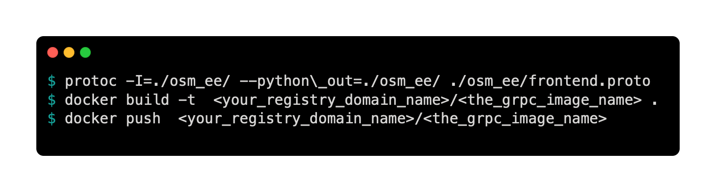
OSM’s gRPC Image – Common Errors
If the OSM's gRPC code is not up to date with Protoc Buffers, to regenerate the protocol buffers do the following:
Download and install the python compiler from ProtoBuf following the instructions in the README file.
Delete frontend_pb2.py and frontend_grpc.py.
$ protoc -I=./osm_ee/ --python\_out=./osm_ee/ ./osm_ee/frontend.proto
$ docker build -t <your_registry_domain_name>/<the_grpc_image_name> .
$ docker push <your_registry_domain_name>/<the_grpc_image_name>
https://www.5gasp.eu

Slide 8
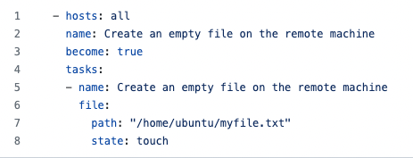
Day 1 primitives with Ansible
All your Ansible playbooks must be present in your Helm chart inside the source folder (simple_ee_vnf/helm-charts/eechart/source)
The goal of the day-1 primitive is to create an empty file on the VNF.
Edit simple_ee_vnf/helm-charts/eechart/source/playbook.yaml and add the following content:
https://www.5gasp.eu

Slide 9
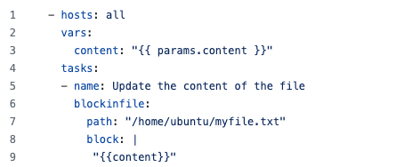
Day 2 primitives with Ansible
The update_file.yaml playbook will be invoked on the day-2 primitive. This primitive will update the file's content with the user input.
Edit simple_ee_vnf/helm-charts/eechart/source/ update_file.yaml and add the following content:
https://www.5gasp.eu

Slide 10
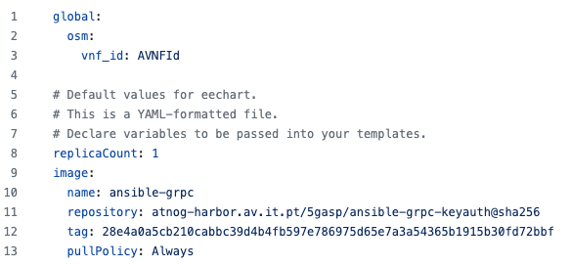
Changing the Helm Chart Manifests
Inside the Helm Chart you may find the file values.yaml which will be used to change variable values, such as the image names used.
Edit simple_ee_vnf/helm-charts/eechart/values.yaml and add the values in the image block, to match your registries’ image.
https://www.5gasp.eu

Slide 11
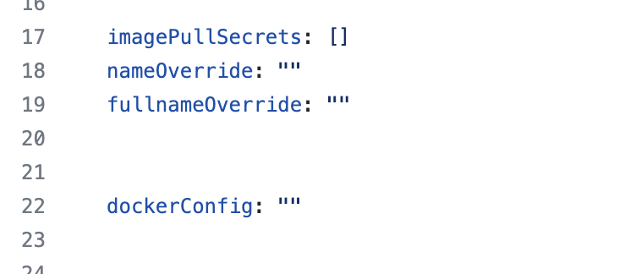

Concerning Image Registries….
In OSM 14, the Helm-Charts are deployed in a namespace created on-the-fly.
However, we cannot share Secrets across namespaces …
One solution can be to include the Image Pull Secret inside the Helm Chart.
Edit simple_ee_vnf/helm-charts/eechart/values.yaml and add the correct dockerConfig to access your registry.
https://www.5gasp.eu

Slide 12
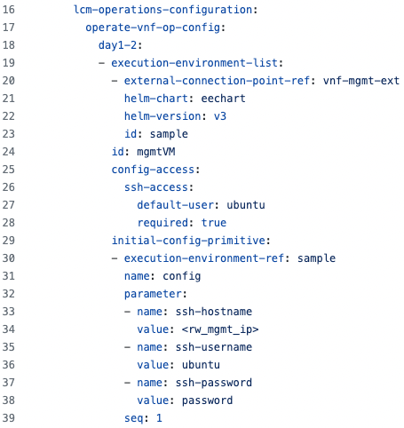
Changing the VNFD – Helm Chart Reference
A pre-requirement to define EE-based primitives is including the appropriate reference in the descriptor to the own EE.
Edit simple_ee_vnf/sample_ee_vnfd.yaml and, inside the df element, add the following block:
https://www.5gasp.eu

Slide 13
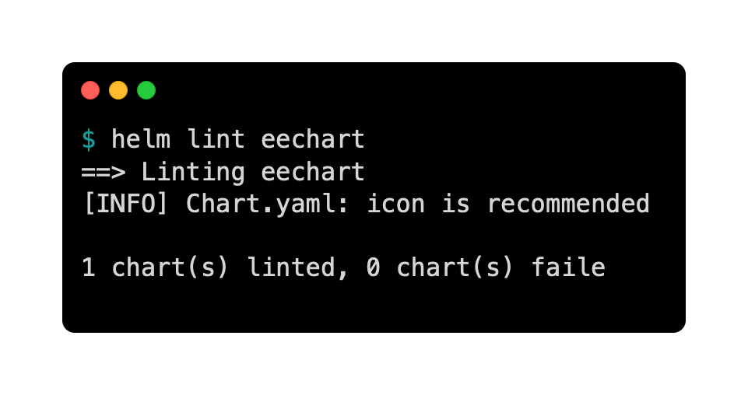
Verifying the Syntax of the Helm Charts
To avoid later errors on OSM, we can right away lint the Helm Chart after the new changes made.
$ helm lint eechart
==> Linting eechart
[INFO] Chart.yaml: icon is recommended
1 chart(s) linted, 0 chart(s) failed
https://www.5gasp.eu

Slide 14
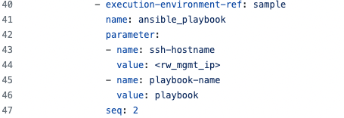
Changing the VNFD – Day 1 Operations
Now we can include the day1-primitive block referencing the playbook.yaml file.
Inside the initial-config-primitive block add the following content:
The parameter's value must match the playbook's file name!
https://www.5gasp.eu

Slide 15
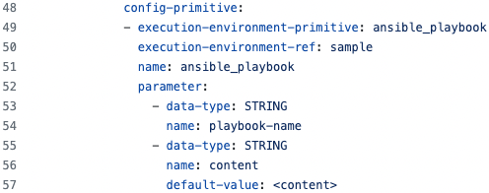
Changing the VNFD – Day 2 Operations
Now, we can add the reference to the day-2 primitive.
The primitive requires two parameters:
the playbook file name
The content to be added to the file created in the day-1 operation
Make sure to add the following block code bellow the initial-config-primitive directive:
https://www.5gasp.eu

Slide 16
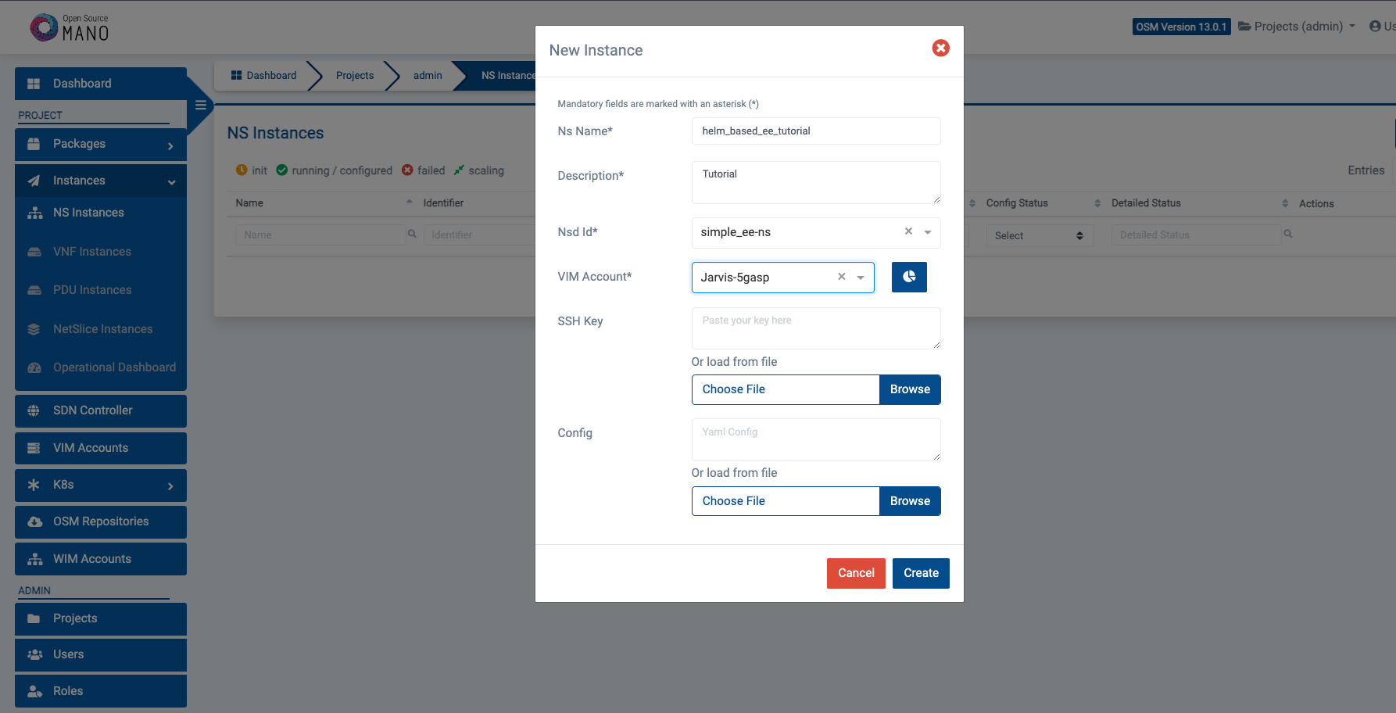
Instantiate the NS
https://www.5gasp.eu

Slide 17
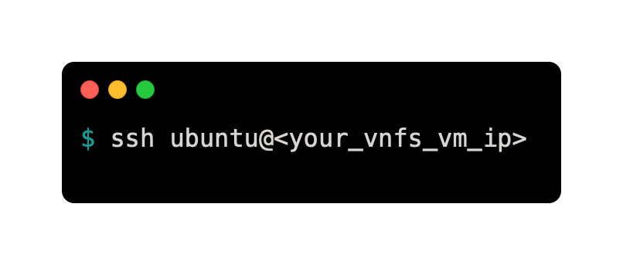
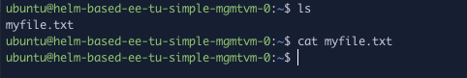
Now, let’s check if the day-1 operation was successful…
$ ssh ubuntu@<your_vnfs_vm_ip>
https://www.5gasp.eu

Slide 18
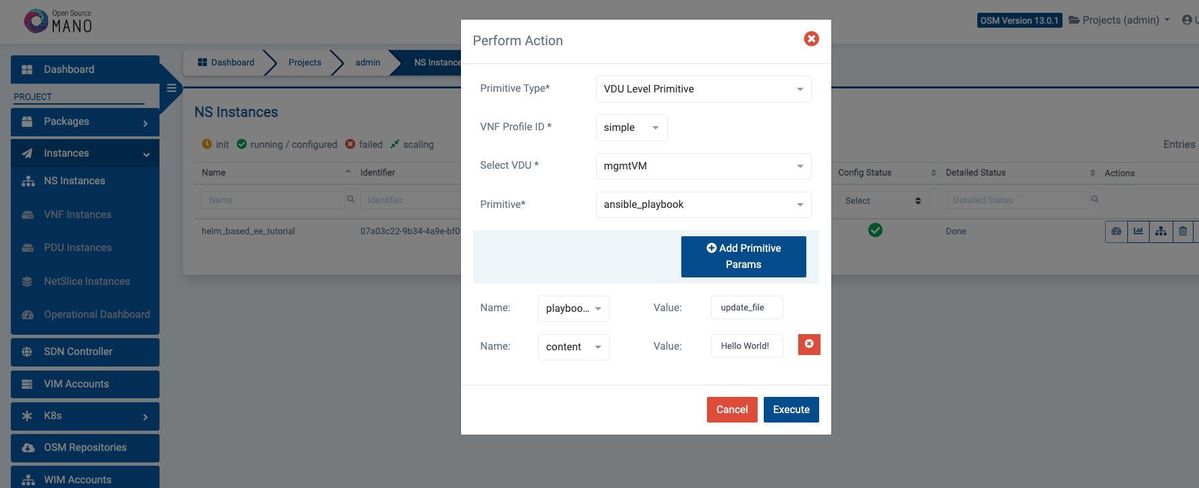
Performing the day-2 operation
Make sure to match the playbook-name’s parameter value to the Ansible Playbook file name!
https://www.5gasp.eu

Slide 19
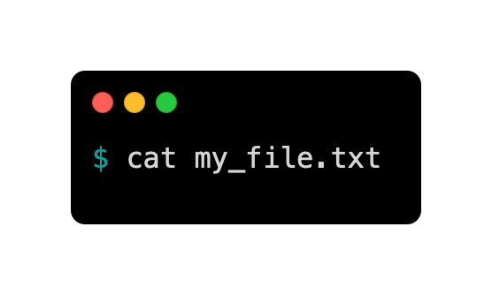
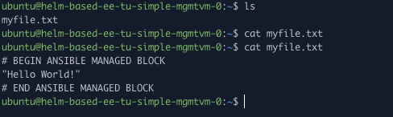
Finally, we can check the new file content…
$ cat my_file.txt
https://www.5gasp.eu

Slide 20
Thank You
Notes:
With the purpose of interconnecting all 5GASP Testbeds, IT Aveiro developed a tool to dynamically orchestrate a mesh network between all project’s facilities.
This solution enables transparent connectivity between the testbeds, relying on Wireguard, for the creation of the VPN tunnels between each domain.

